Slide 1
GoogleNet
Krishna
Lavanya

Slide 2
What is GoogLeNet?
In the last Ten years, mainly due to the advances of deep learning, more concretely convolutional networks, the quality of image recognition and object detection has been progressing at a dramatic pace.
One encouraging news is that most of this progress is not just the result of more powerful hardware, larger datasets and bigger models, but mainly a consequence of new ideas, algorithms and improved network architectures.
Form this idea only the new algorithm evolves is GoogLeNet.
Google isn’t just about text anymore. The search giant is making great strides in understanding and indexing images. Google’s GoogLeNet project was one of the winning teams in the 2014 ImageNet large-scale visual recognition challenge (ILSVRC).
The main hallmark of this architecture is the improved utilization of the computing resources inside the network. This was achieved by a carefully crafted design that allows for increasing the depth and width of the network while keeping the computational budget constant.

Slide 3
Why we need a project for Visual recognition by computers?
Now, a days the world is growing so fast and everything is becoming automate. Photos and videos are become integral part of global life and they are being generated at a phase that very far behind that a human or teams of human could hope to view. can a very In that sense, we need Machine Learning.
Examples where Machine Learning comes into picture?
We have prototype cars that can drive by them selves but, with out smart vision they can not really differentiate between a crumble paper on the road which the car can be run over and the rock that size which car should avoid.
Drones can flyover massive length but not enough vision technology to track the changes of the rain forest.
We have security cameras but they do not alert us when a child is drowning in a swimming pool.
These networks are attempting to mimic the way our brains work
In these Networks, GoogLeNet is one

Slide 4
Reasons to care About GoogLeNet:
GoogLeNet project was one of the winning teams in the 2014 ImageNet large-scale visual recognition challenge (ILSVRC).
It is the first network to come up with efficiency means smaller and faster models.
Google net introduces successful tools like Pooling and dropouts for regularisation.
It consumes 12 times lesser parameters than Alex net.
It is significantly more accurate than Alex Net, Lower memory use and Lower power use.

Slide 5
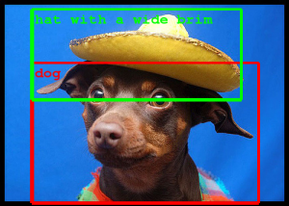
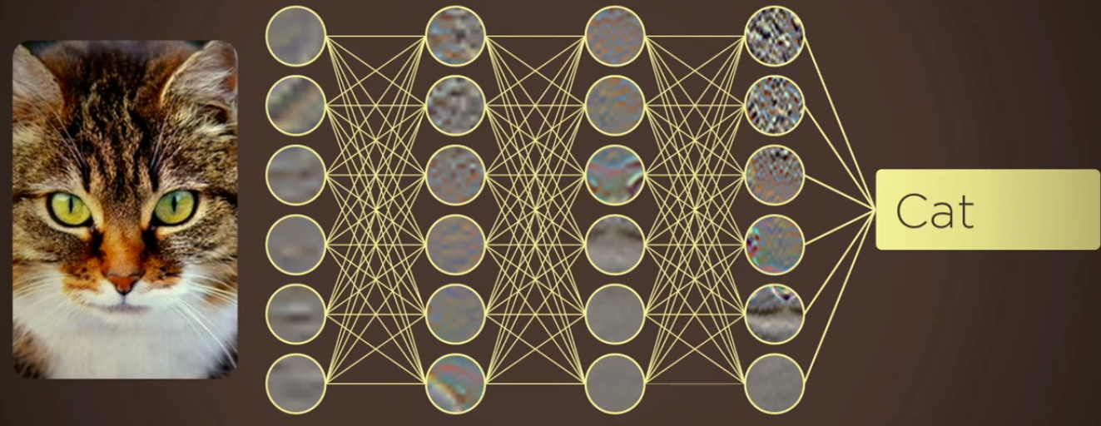
What GoogLeNet is Doing mainly?
What we observed from the given image?
Answer:
Human eye: A dog in a hat
Computer Answer: A hat and a dog;
with all the computing expertise in the word, how hard is it to figure out that this is a dog in a hat?
The answer: very hard.

Slide 6
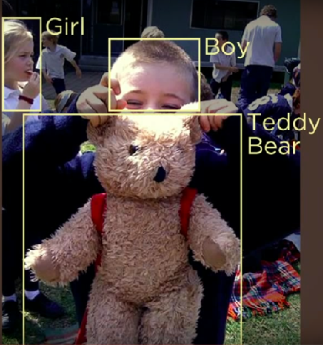
Some more images how computer is Identifying:

Slide 7
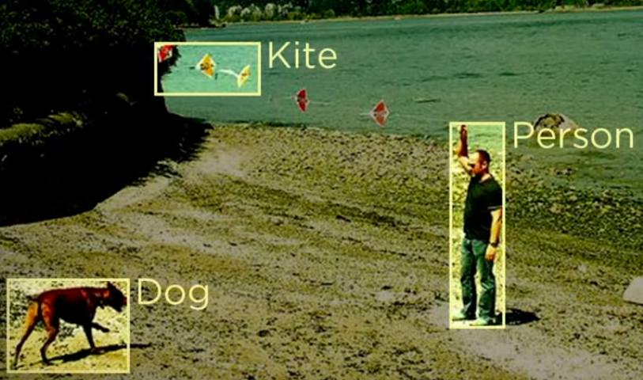
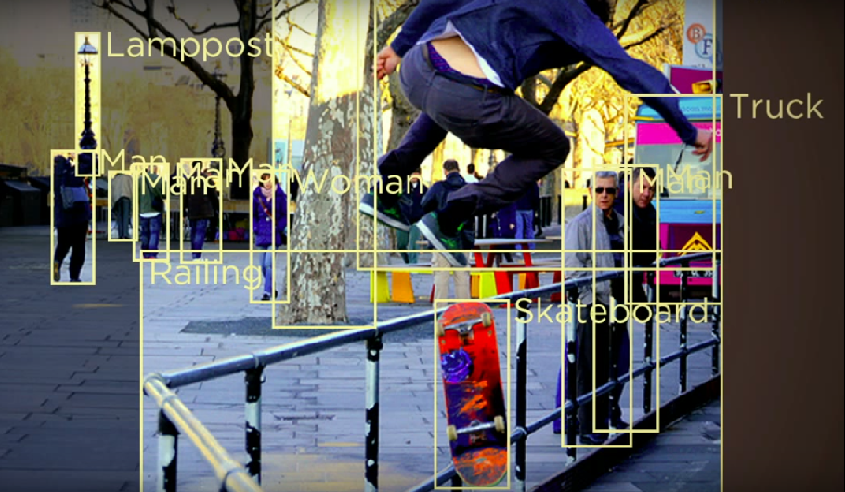

Slide 8
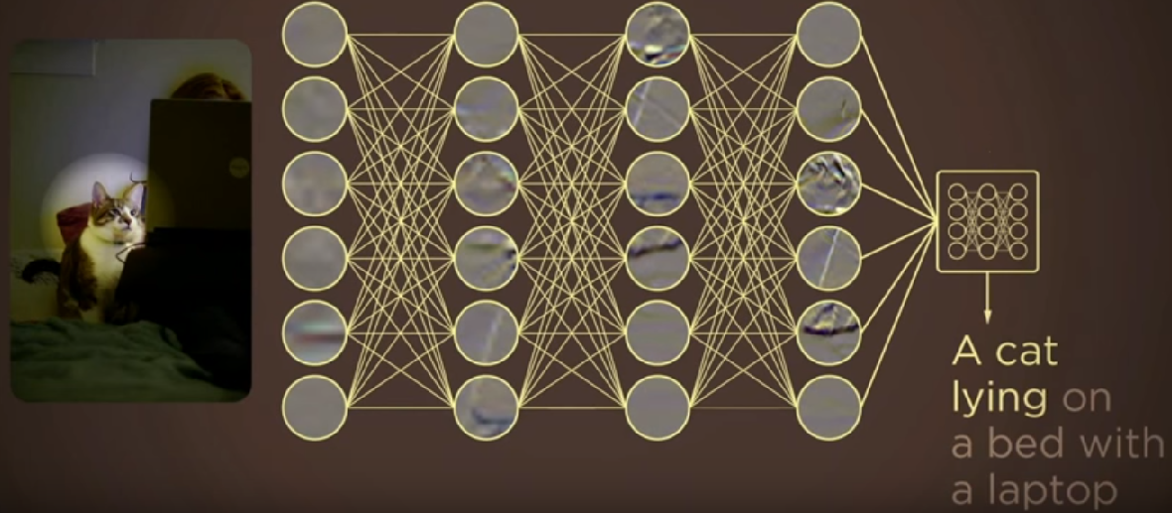

Slide 9

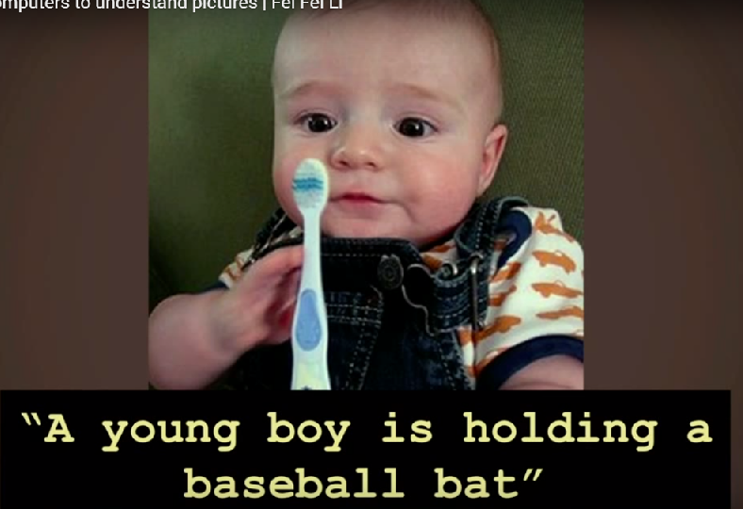

Slide 10
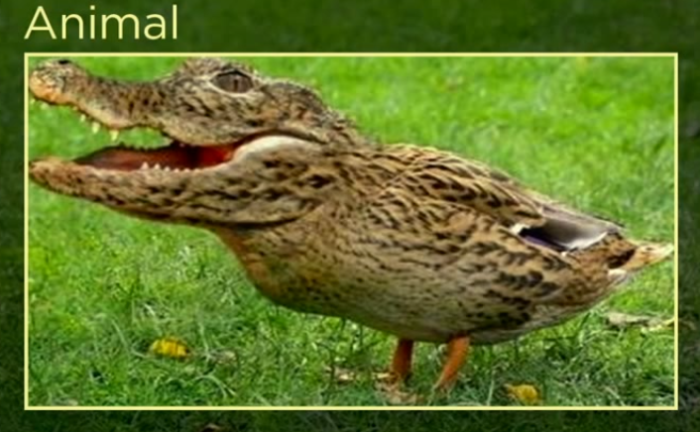
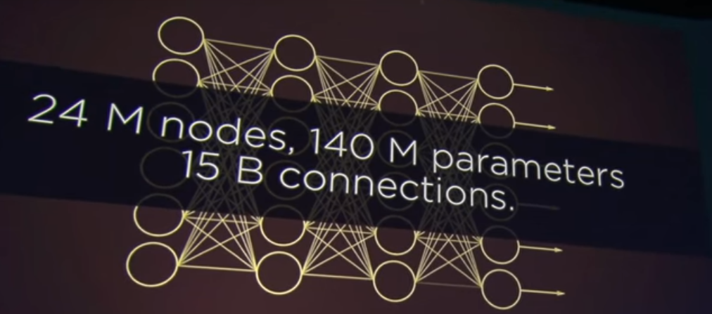

Slide 11
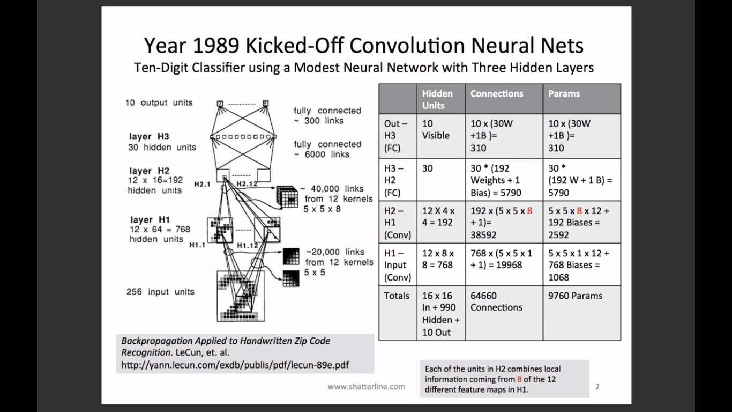
Evolution of Neural Network Architecture:

Slide 12
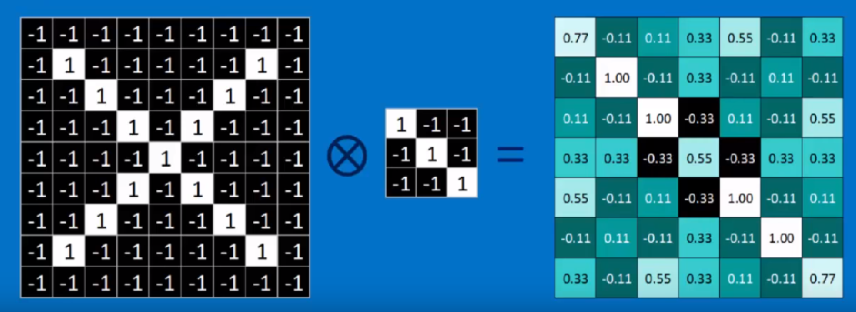
How the Image will be processed by a computer?
The computer process the images after went through different layers and many stages:
Step1: CONVOLUTION
The first layers that receive an input signal are called convolution filters.
Convolution is a process where the network tries to label the input signal by referring to what it has learned in the past.
If the input signal looks like previous cat images it has seen before, the “cat” reference signal will be mixed into, or convolved with, the input signal.
Convolution has the nice property of being translational invariant.
Hence, a cat could be sitting in different positions, and the CNN algorithm would still be able to recognize it.

Slide 13
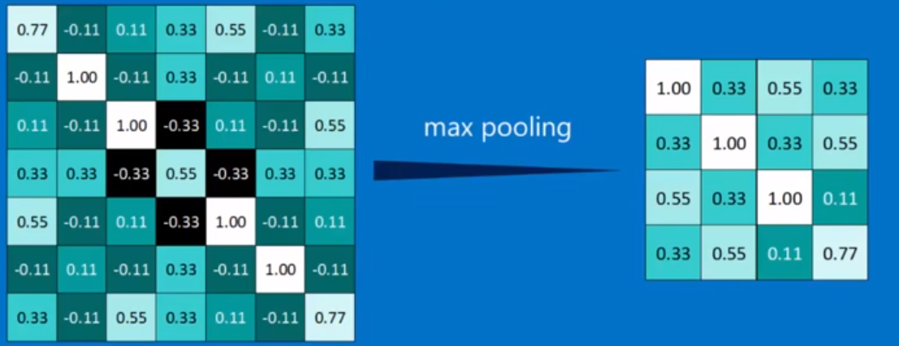
Step 2: Subsampling/Pooling:
Inputs from the convolution layer can be “smoothened” to reduce the sensitivity of the filters to noise and variations.
This smoothing process is called subsampling, and can be achieved by taking averages or taking the maximum over a sample of the signal.
This layer reduce the spatial size of the representation to reduce the amount of features and the computational complexity of the network.
The more commonly used pooling layer is the MAXPOOL layer, with is provided by all deep learning libraries.
This layer is used to shrink the image stack.

Slide 14
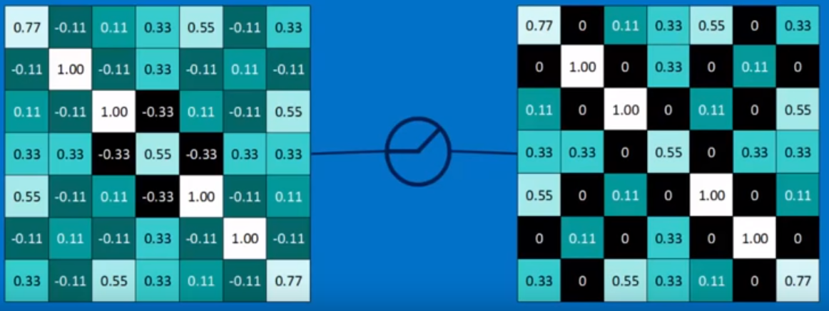
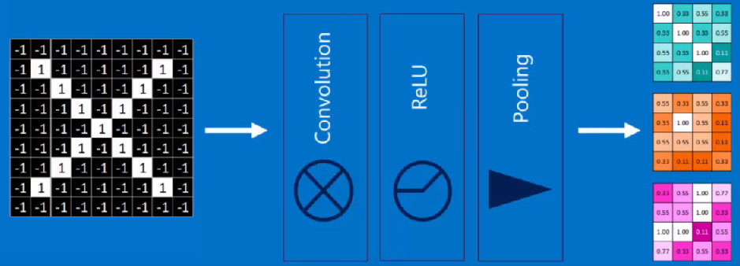
Step3: Rectified Linear units(ReLUs):
This layer converts all the negative values in the Matrix will be converted into the zero.
A stack of images will become the stack of images with no negative values.
These Output matrices shown, are after completion of first layer. The same matrices will be given to the next layer where this layer also will go through all the phases/steps for further reduction in image size.

Slide 15
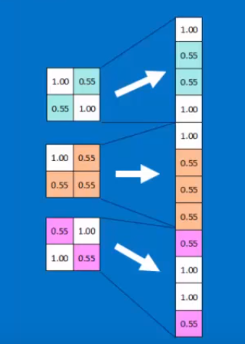
Activation Layer:
The activation layer controls how the signal flows from one layer to the next, emulating how neurons are fired in our brain.
Output signals which are strongly associated with past references would activate more neurons, enabling signals to be propagated more efficiently for identification.
Fully Connected Layer:
The last layers in the network are fully connected, meaning that neurons of preceding layers are connected to every neuron in subsequent layers.
This mimics high level reasoning where all possible pathways from the input to output are considered

Slide 16

In the below image we can observe many “hidden layers” nothing but, each hidden layer is made up of a set of neurons, where each neuron is fully connected to all neurons in the previous layer.
The last fully-connected layer is called the “output layer” and in classification settings it represents the class scores

Slide 17
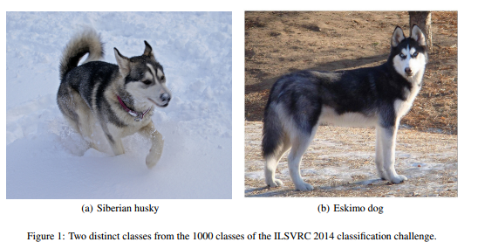
Motivation and High Level Considerations:
The biggest gains in object-detection have not come from the utilization of deep networks alone or bigger models, but from the synergy of deep architectures and classical computer vision, like the R-CNN algorithm by Girshick.
The most straightforward way of improving the performance of deep neural networks is by increasing their size. This includes both increasing the
depth – the number of levels – of the network and
width: the number of units at each level.
This is as an easy and safe way of training higher quality models, especially given the availability of a large amount of labelled training data.

Slide 18
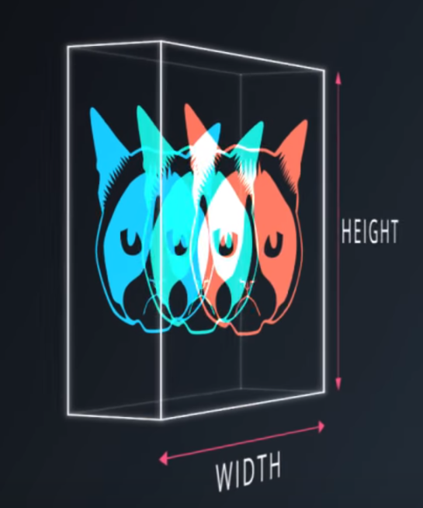
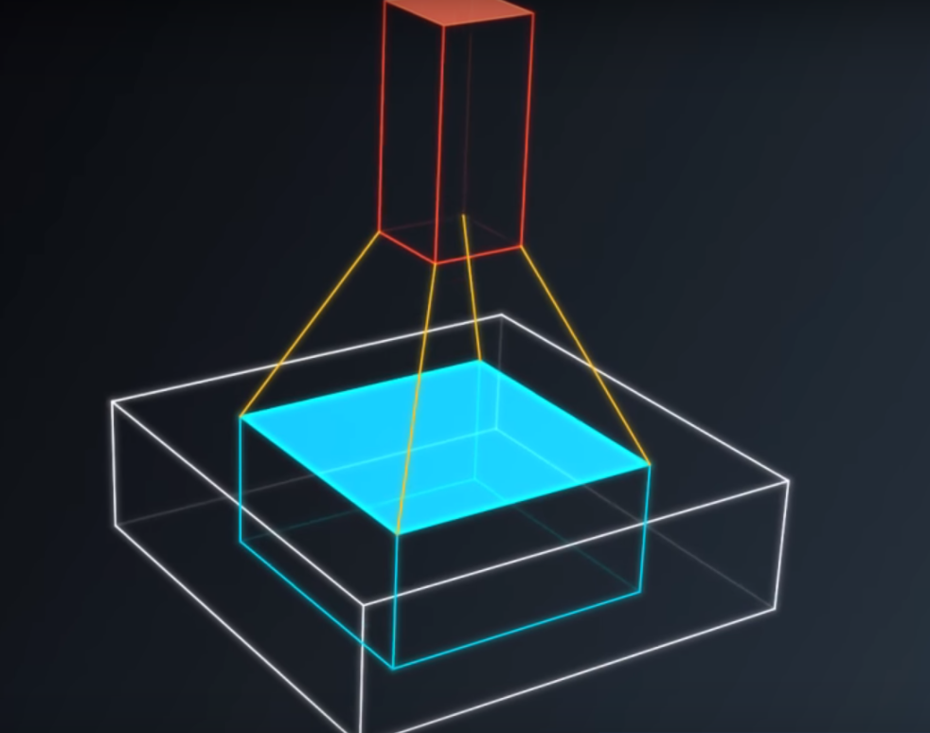
Convolution:

Slide 19
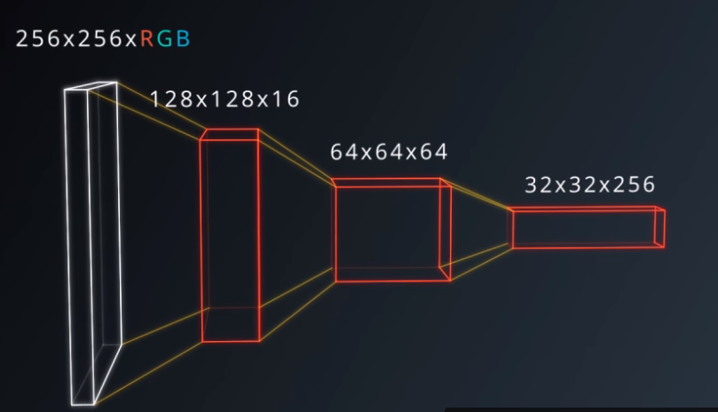
Apply convolutions:
We apply the convolution that are going to progressively squeeze the spatial dimensions while increasing the depth.
Now a classifier can be easily applied for thus output, and parameters that match the image remain.

Slide 20
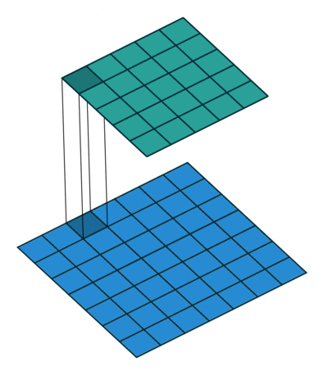
A 1 x 1 Convolution:
Most simplistic explanation would be that 1x1 convolution leads to reduction in dimensions.

Slide 21
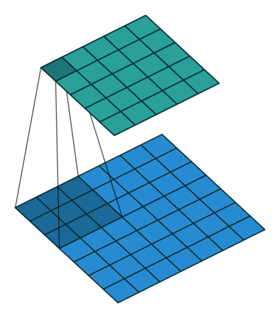
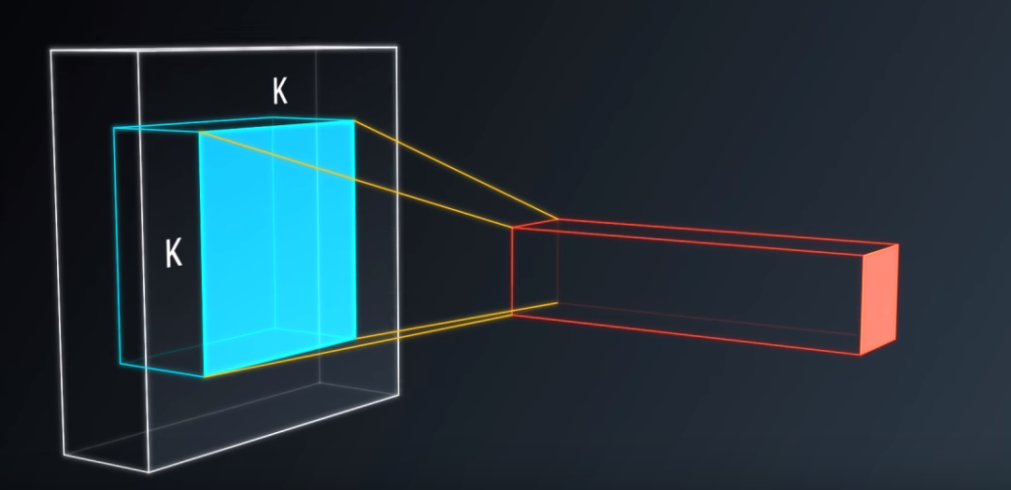
Why?
Classic convolution setting is basically a small classifier for a patch of a image but it’s only a linear classifier

Slide 22
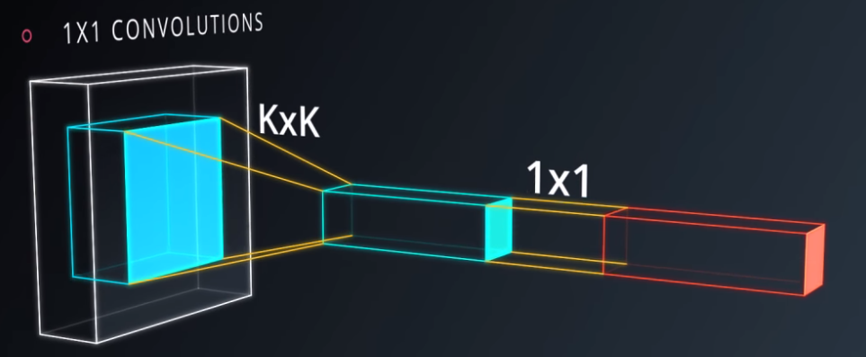
But if you add a 1 x 1 convolution in the middle suddenly you have a mini neural net running over the patch instead of a linear classifier.

Slide 23
The 1x1 convolutional filter behaves exactly the same as “normal” filters
The only confused thing is the size 1x1 is that, there is no visual pattern being learned in here.
Instead, the filter pools the information across multi feature maps.

Slide 24
This can be very inexpensive way to make the models deeper and involve more parameters without completely changing their structure
Very simple because the math of 1 x 1 includes mainly nothing more than matrix multiplications.
1x1 Convolution can be combined with Max pooling
1x1 Convolution with higher strides leads to even more reduction in data by decreasing resolution, while losing very little non-spatially correlated information.

Slide 25
Example:
Suppose that I have a conv layer which outputs an (F,H,W) shaped object
Where :
F is the number of convolutional filters
H,W are the spatial dimensions

Slide 26
Suppose this output is fed into a conv layer with F1 1x1 filters and stride 1.
Then the output of this 1x1 conv layer will have shape (F1,H,W).
So 1x1 conv filters can be used to change the dimensionality in the filter space.

Slide 27
If F1>F then we are increasing dimensionality.
If F1<F we are decreasing dimensionality, in the filter dimension.

Slide 28
Inception Module…
Considered as Heart of GoogLeNet.
The module basically acts as multiple convolution filter inputs, that are processed on the same input.
It also does pooling at the same time. All the results are then concatenated.
This allows the model to take advantage of multi-level feature extraction from each input.
For instance, it extracts general (5x5) and local (1x1) features at the same time

Slide 29
In GoogLeNet architecture, 1x1 convolution is used for two purposes
To make network deep by adding an “inception module”.
To reduce the dimensions inside this “inception module”.
To add more non-linearity by having ReLU immediately after every 1x1 convolution.

Slide 30
The idea is that, at each layer of your covnet you can make a choice.
This means, you can have a pooling operation, or any other convolution. (1x1 or 3x3 etc )
Since all of these are beneficial to the network, the inception module uses all of them instead of choosing in between.

Slide 31
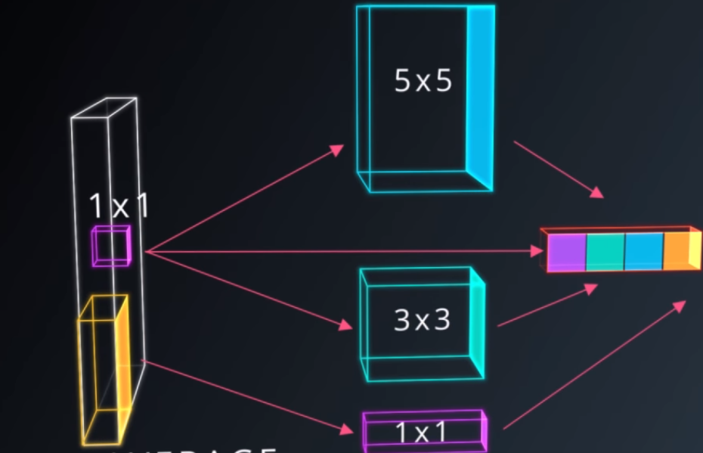

Slide 32
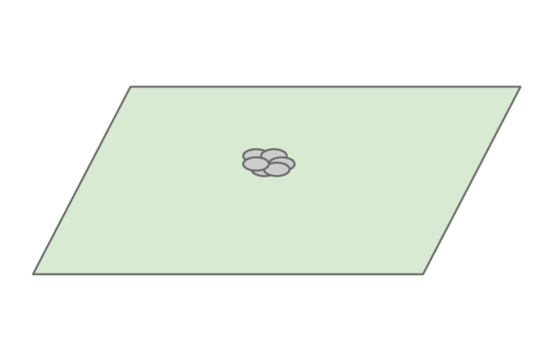

Slide 33
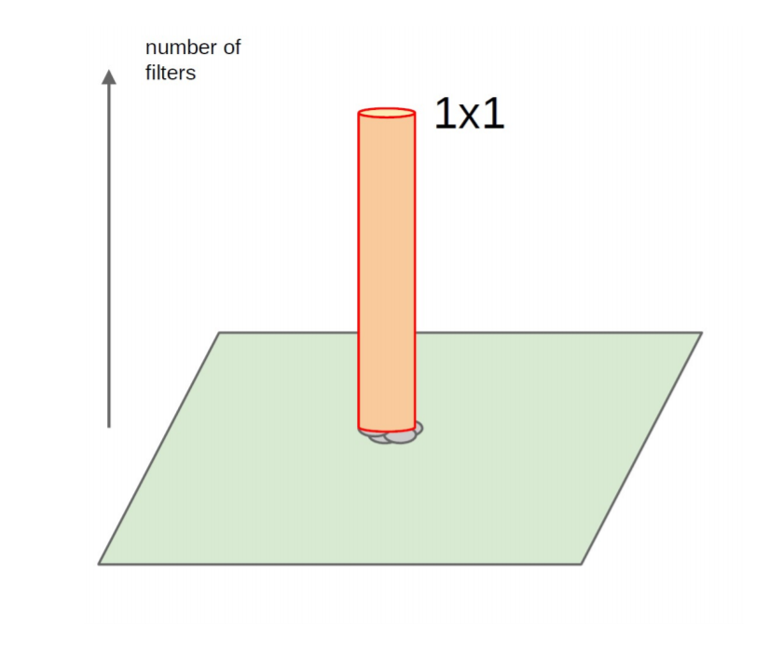

Slide 34
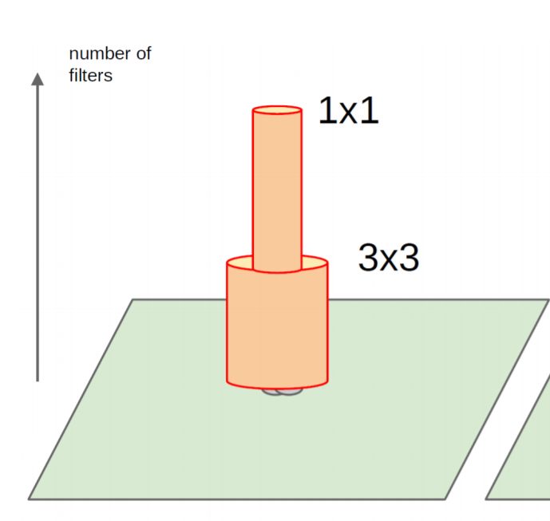

Slide 35
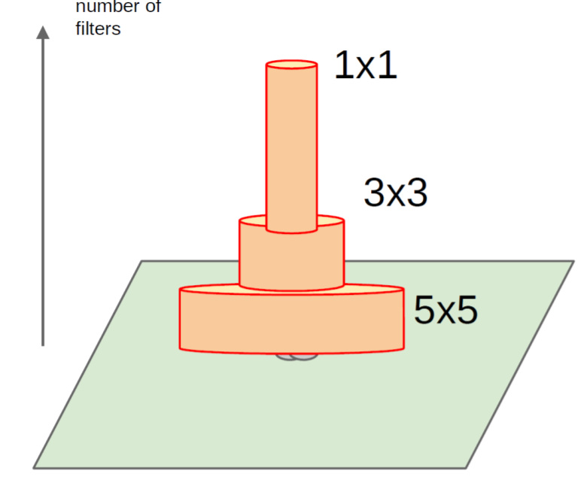

Slide 36
One big problem with the above modules, at least in this naive form, is that even a modest number of 5x5 convolutions can be prohibitively expensive on top of a convolutional layer with a large number of filters.

Slide 37
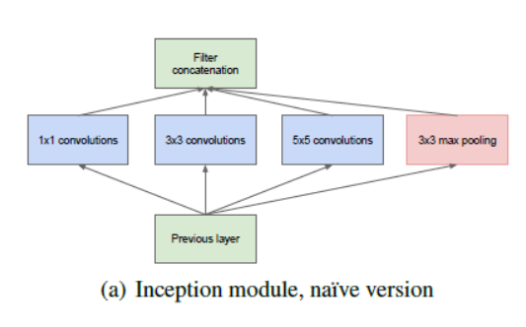

Slide 38
This leads to the second idea of the proposed architecture: judiciously applying dimension reductions and projections wherever the computational requirements would increase too much otherwise.
1x1 convolutions are used to compute reductions before the expensive 3x3 and 5x5 convolutions. Besides being used as reductions, they also include the use of rectified linear activation which makes them dual-purpose.

Slide 39
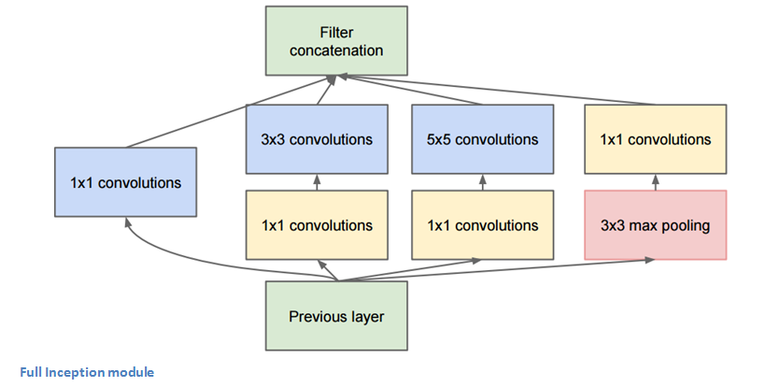

Slide 40
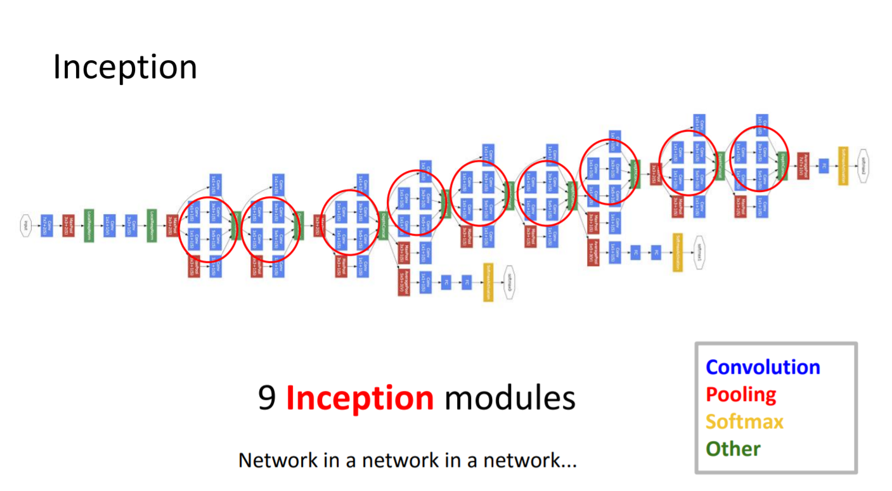

Slide 41
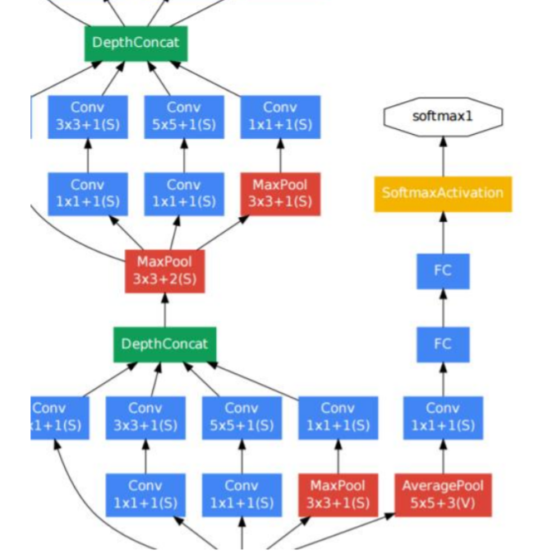
A Closer look:

Slide 42
So in the Inception architecture, we use the 1x1 convolutional filters to reduce dimensionality in the filter dimension.
These 1x1 conv layers can be used in general to change the filter space dimensionality (either increase or decrease) and in the Inception architecture will show how effective these 1x1 filters can be for dimensionality reduction, explicitly in the filter dimension space, not the spatial dimension space.

